Slide 1



PSAS Electric Propellant Feed System
Affiliations: ¹Portland State Aerospace Society, ²Maseeh College of Engineering and Computer Science Portland, OR, 97201, United States

Slide 2
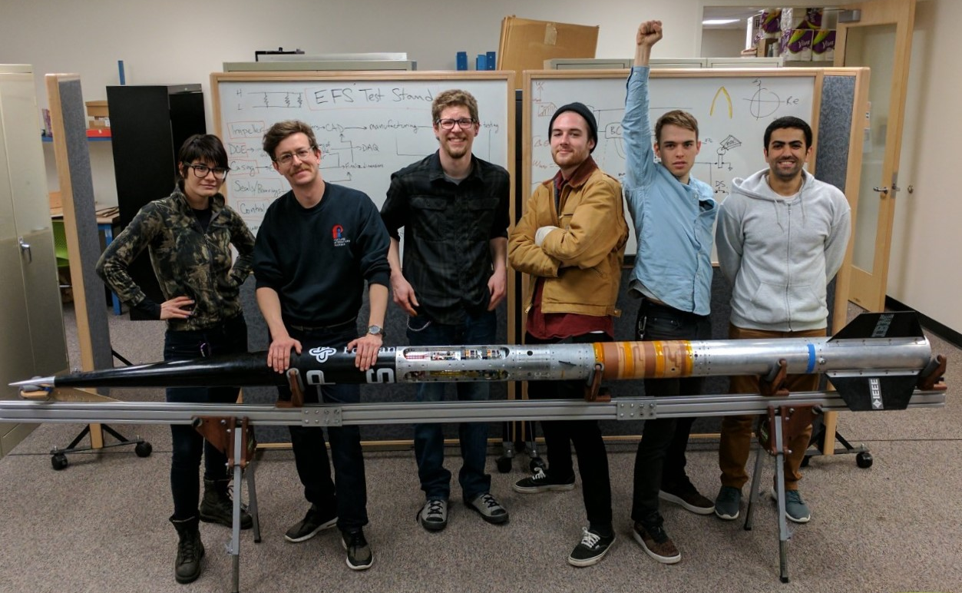
The Team
Team Members (left to right):
Mimi Shang, James Luce, Jorden Roland, Johnny Froehlich, Johnathan Talik, Rawand Rasheed

Slide 3
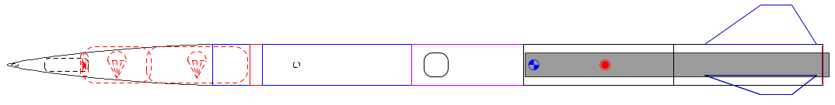
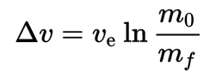
The Problem
Portland State Aerospace Society (PSAS) wants its rockets to go higher, but mass is the enemy:
Δv = change in velocity
V_{e} = exhaust velocity
m_{o} = mass of rocket + propellant
m_{f} = mass of rocket

Slide 4
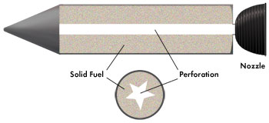
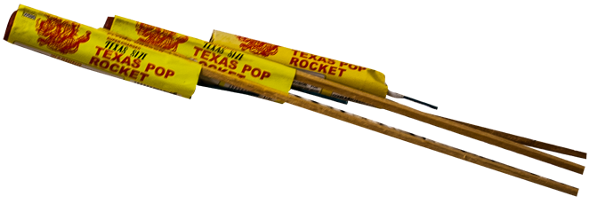
Past approach: solid propellant
Most small rockets use solid propellant.
Simple but inefficient.
Can’t throttle = can’t insert into orbit.
Solid propellant
Nozzle
Grain bore
Solid propellant rocket design
Solid propellant rocket example
Images: http://www.fireworkssupermarket.com, http://www.aerospace.org

Slide 5
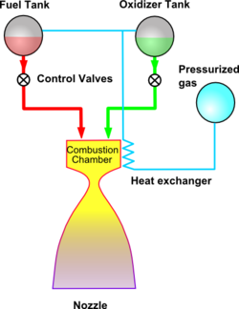
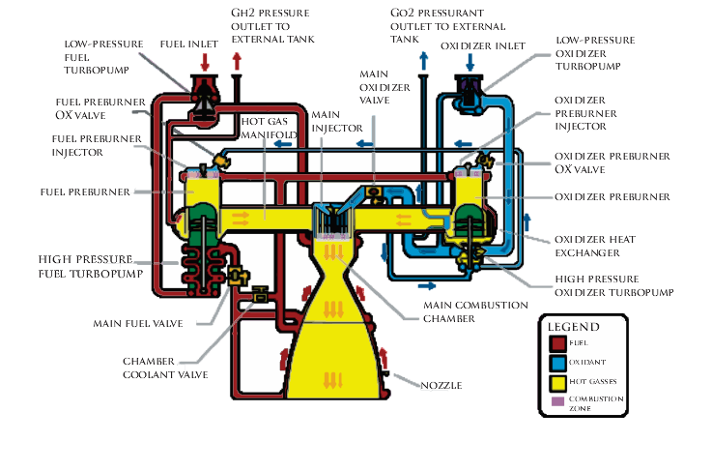
Liquid propellant
Gives more Δv for its mass = goes higher.
Can be throttled = can insert into orbit.
Pressure fed: too heavy
Turbopump: too complex
Images from wikipedia

Slide 6
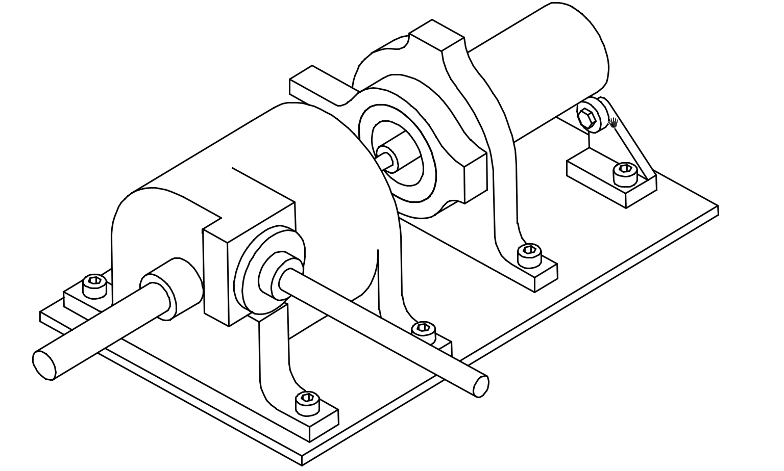
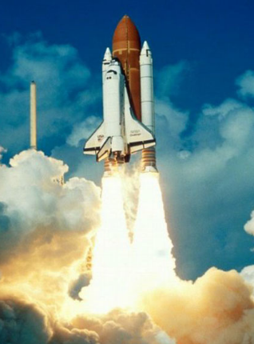
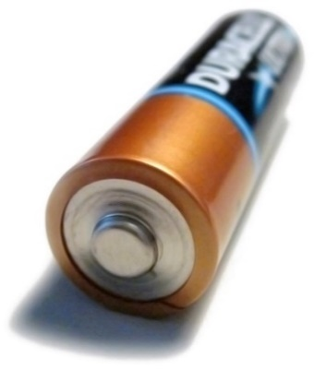
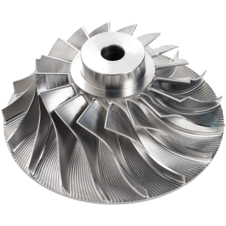
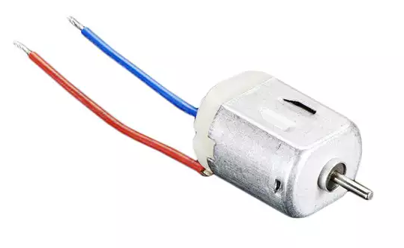
New approach: electric pump
Turbopump without turbine = just a pump.
Battery energy density has been rising.
Lighter than pressure fed, simpler than turbopump.
Electric motor
Pump
Tank
Engine
https://en.wikipedia.org/
http://www.blue-sky-technologies.com/impeller-seal-repair/
https://www.digikey.com/

Slide 7
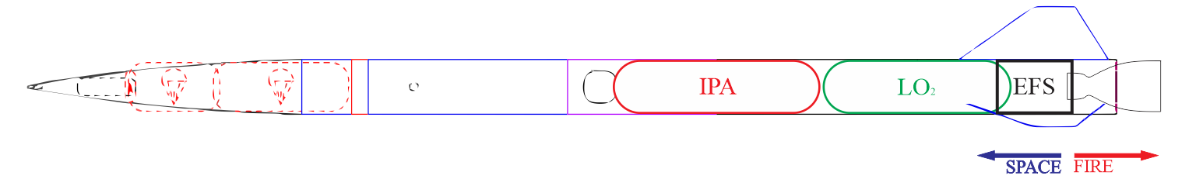
Project Goal
Goal:
Design a test pump to meet PSAS’ requirements.
Test with water (not cryogenic liquid oxygen and isopropyl alcohol).
Performance results will be scaled to design actual rocket pump.

Slide 8
Customer Requirements
Pressure delivery | Must produce discharge pressures of 300-400 psi.
Flow capacity | Must supply a flow rate of ~12 gpm.
Transferability | Documentation must be open source and transferable to future PSAS engineers.
Off-the-shelf components | Must utilize off the shelf components wherever possible.
Cost | Project must be completed for less than $8000

Slide 9
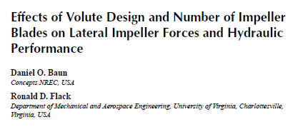
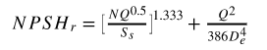
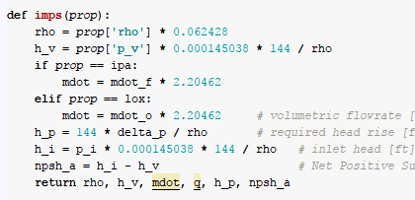
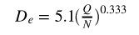
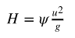
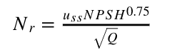
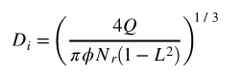
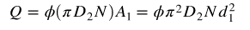
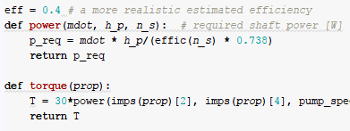

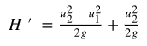
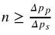
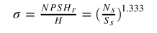
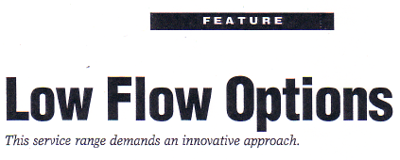
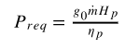
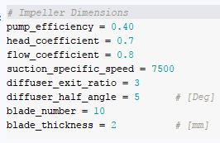
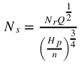
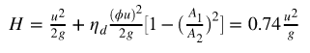
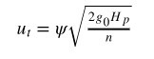
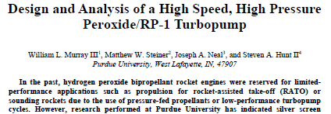
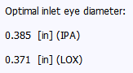
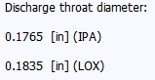
Getting started
Open-ended literature review
Scientific computing
Math is involved
Some
assumptions
Notes:
literature review to narrow the region of interest. (Don’t solve problems we don’t have to)
Scientific computing as an example of using tools to implement theory OR IDEAS. Matercam, SW, Python, Arduino
Allows us to make calculations (OR DESIGNS) over a wide range of values and explore a little.
We can iteratively develop
note:
Guessing is cheaper
If best head coeff is between 0.5 and 1 we use 0.75 ☺

Slide 10
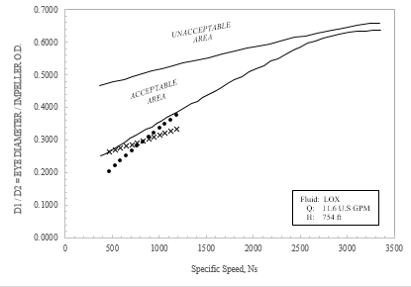
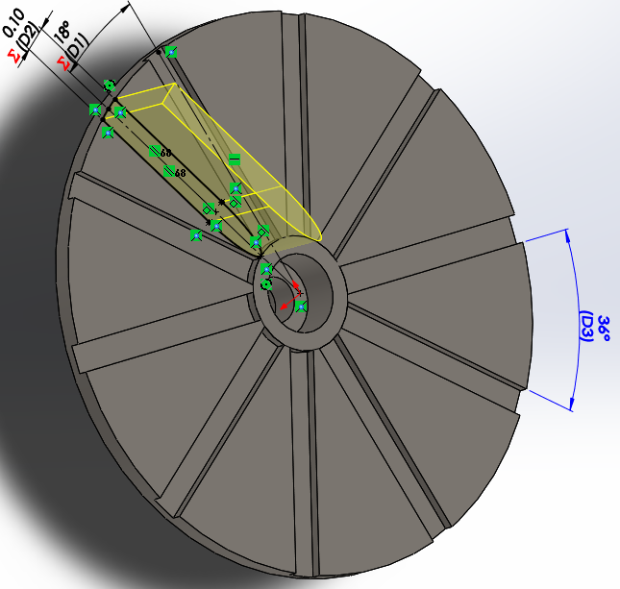
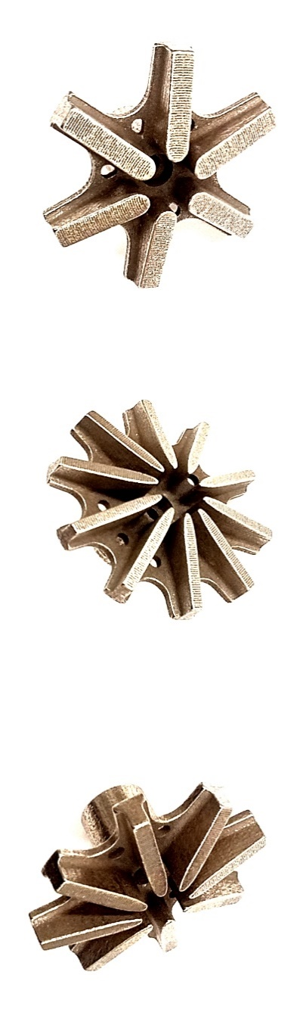
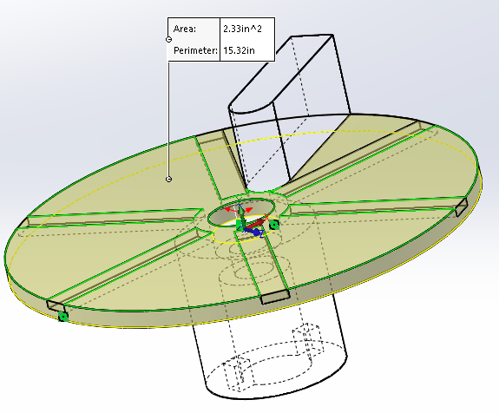
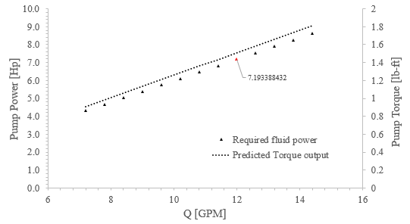
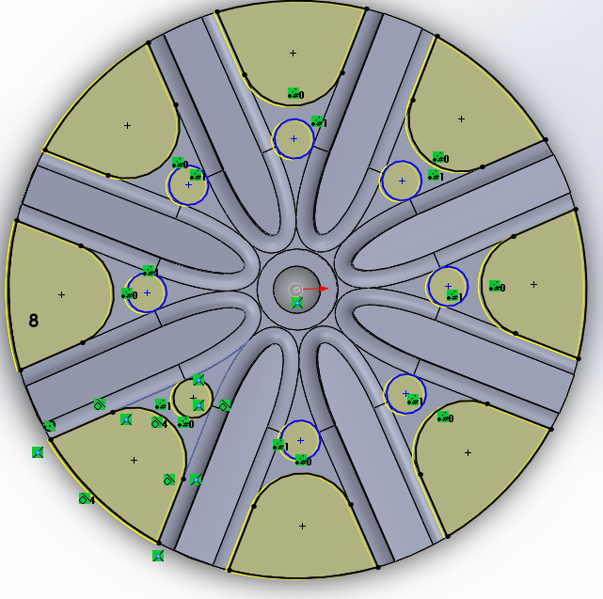
Getting started
Visualize the Results
Parametric Design
Viola!
You are here
Notes:
literature review to narrow the region of interest. (Don’t solve problems we don’t have to)
Scientific computing as an example of using tools to implement theory OR IDEAS. Matercam, SW, Python, Arduino
Allows us to make calculations (OR DESIGNS) over a wide range of values and explore a little.
We can iteratively develop
note:
Guessing is cheaper
If best head coeff is between 0.5 and 1 we use 0.75 ☺

Slide 11
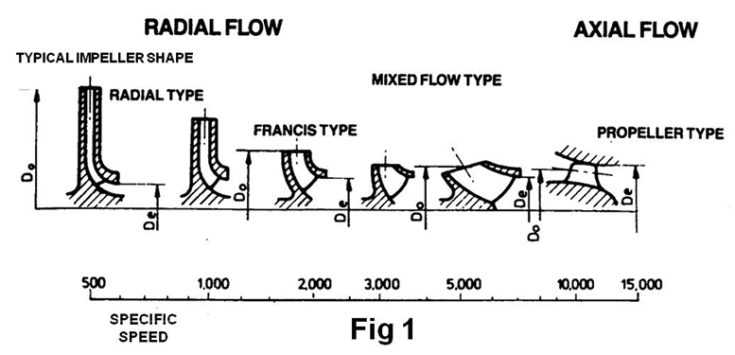
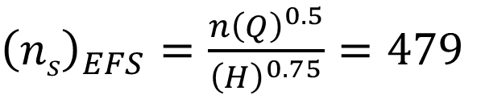
Pump regimes
Specific speed is a term used to describe the geometry (shape) of a pump impeller.
${\left(ns\right)}_{EFS}=\frac{n{\left(Q\right)}^{0.5}}{{\left(H\right)}^{0.75}}=479$
Our specific speed
Very Low
Low
?
?
?
?
Notes:
literature review to narrow the region of interest. (Don’t solve problems we don’t have to)
Scientific computing as an example of using tools to implement theory OR IDEAS. Matercam, SW, Python, Arduino
Allows us to make calculations (OR DESIGNS) over a wide range of values and explore a little.
We can iteratively develop
note:
Guessing is cheaper
If best head coeff is between 0.5 and 1 we use 0.75 ☺

Slide 12
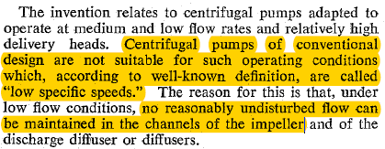
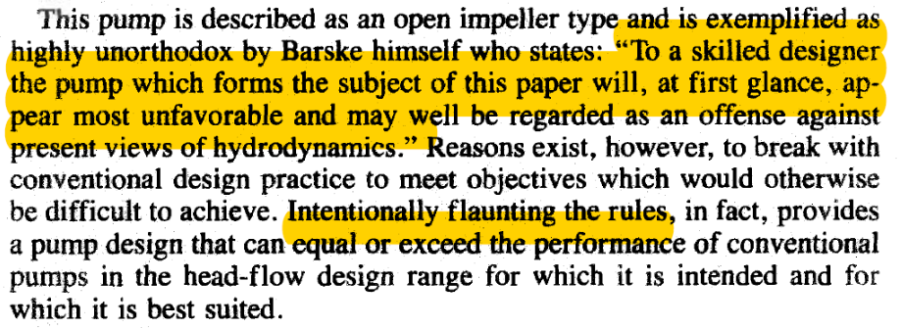
Searching for clues
Notes:
literature review to narrow the region of interest. (Don’t solve problems we don’t have to)
Scientific computing as an example of using tools to implement theory OR IDEAS. Matercam, SW, Python, Arduino
Allows us to make calculations (OR DESIGNS) over a wide range of values and explore a little.
We can iteratively develop
note:
Guessing is cheaper
If best head coeff is between 0.5 and 1 we use 0.75 ☺

Slide 13
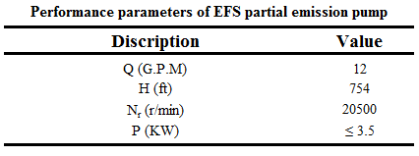
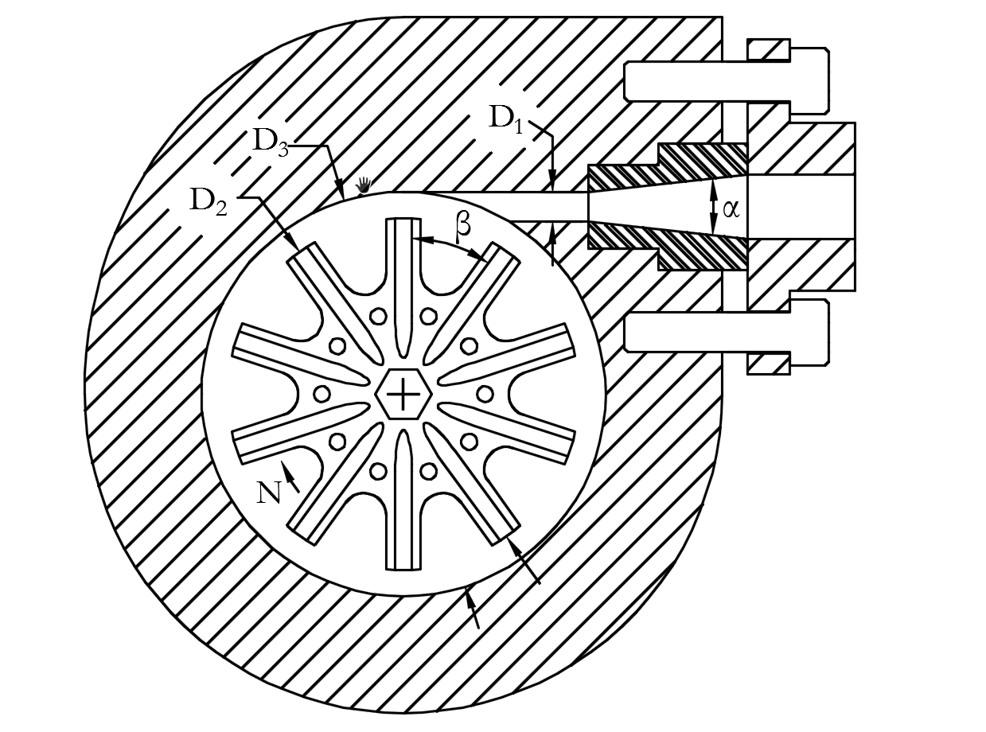
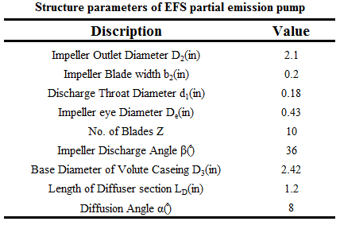
Searching for clues
Final parameters of hydraulic structure
Salient Features:
Semi-open impeller
Flow enters axially and exits radially
Casing is bored concentrically with impeller centerline
Fluid allowed to recirculate within the casing
Single emission throat
Conical diffuser oriented tangentially to the case bore
Notes:
literature review to narrow the region of interest. (Don’t solve problems we don’t have to)
Scientific computing as an example of using tools to implement theory OR IDEAS. Matercam, SW, Python, Arduino
Allows us to make calculations (OR DESIGNS) over a wide range of values and explore a little.
We can iteratively develop
note:
Guessing is cheaper
If best head coeff is between 0.5 and 1 we use 0.75 ☺

Slide 14
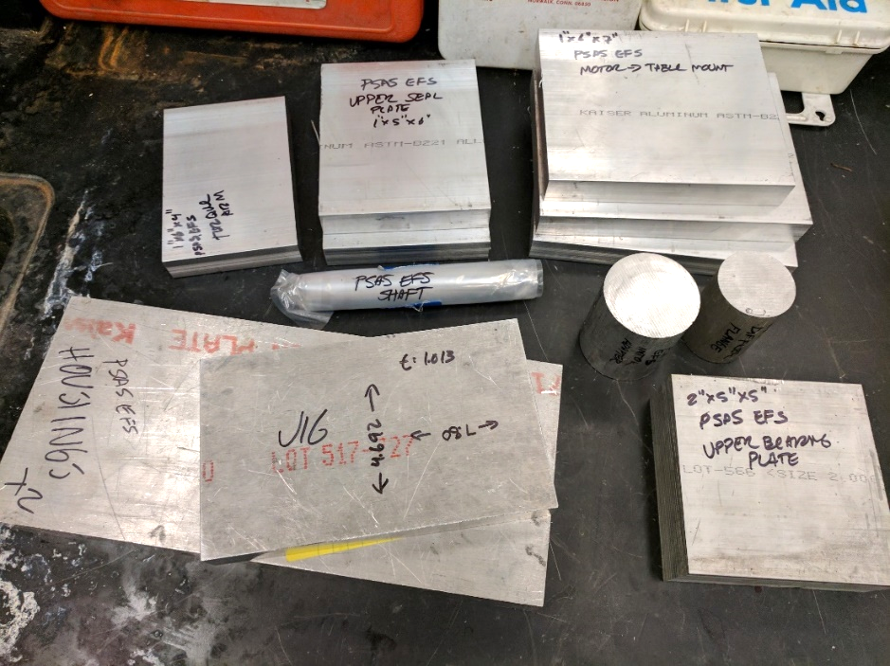
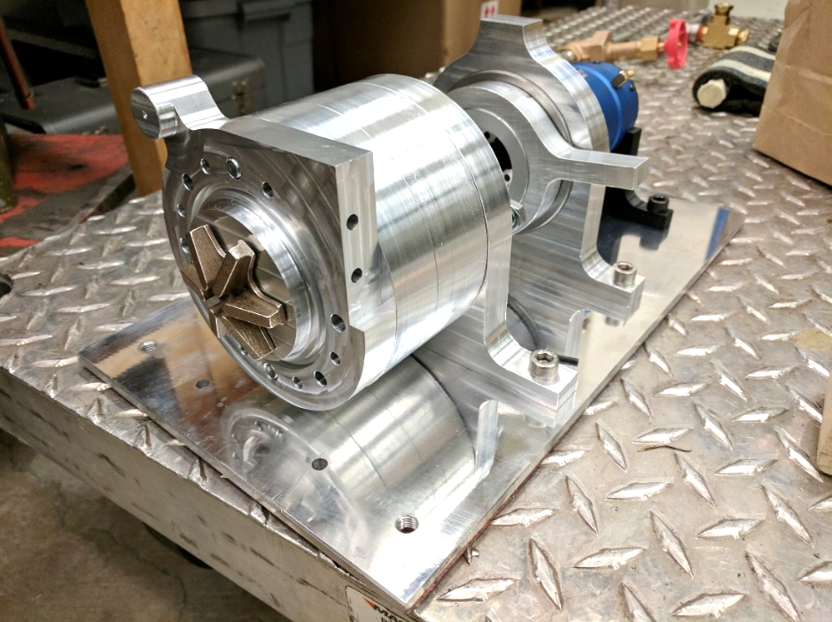
Challenge: Fabrication
Head v. flow requirements meant commercially available pumps wouldn’t work.
Outsourcing fabrication would be cost prohibitive.

Slide 15
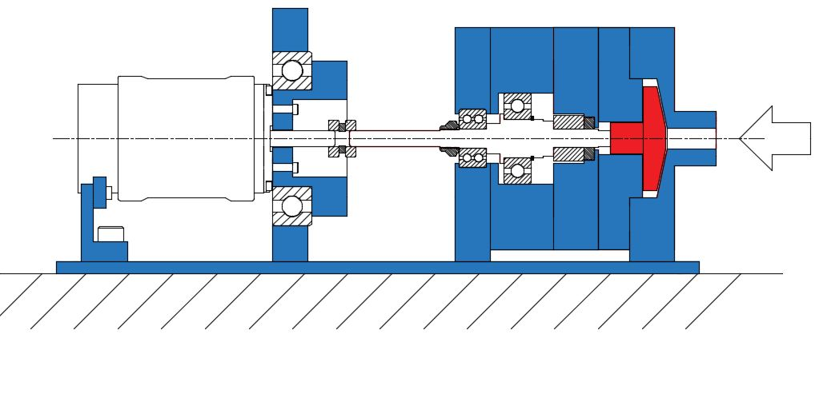



Challenge: Precision
High speeds and loads with low tolerances meant fabrication had to be precise.
+/- ~0.0007”
0.06” +/- 0.01”
Impeller (cross section)

Slide 16



Solution: Time investment
Designed parts around available fabrication techniques.
Learned 3-axis CNC mill and 2 axis CNC lathe.
Several thousand (wo)man hours in the shop.

Slide 17





Solution: Time investment

Slide 18




Solution: Time investment

Slide 19

Solution: Time investment

Slide 20




Challenge: Power measurement
We need to know the power applied to the fluid.
Hard to extract this data directly from motor.
Solution: live dynamometer.
“floating” motor adapter
motor
bearing
torque arm

Slide 21
Subsystem structure
EFS Subsystems
Hydraulic
Mechanical
Power
Flow Loop
Measurement
Impeller
Diffuser
Volute
Bearings
Seals
Shaft
Coupling
Alignment
Motor
Batteries
ESC
Control
Supply Tank
Valves
Tubing
Arduino
Excel DAQ
Sensors

Slide 22

Subsystem structure
Mechanical
Bearings
Seals
Shaft
Coupling
Alignment
Power
Motor
Hydraulic
Impeller
Diffuser
Volute

Slide 23

Subsystem structure
Hydraulic
&
Mechanical
Flow Loop
Supply Tank
Valves
Tubing
Impeller
Diffuser
Volute
Bearings
Seals
Shaft
Coupling
Alignment
Power
Measurement
Motor
Batteries
ESC
Control
Cooling
Arduino
Excel DAQ
Sensors

Slide 24

Characterizing the performance
Hydraulic Institute Test Standard (ANSI/HI 14.6)
Pump performance is given by:
• Head versus capacity
• Power versus capacity
• NPSH versus capacity

Slide 25




System characteristics
Energy Equation
Swamee-Jain Equation (1976)
Explicit expression 10⁻⁶ < e/D, 10⁻²; 5000 < N^{R} < 10⁸

Slide 26



Measurement
Optical sensor

Slide 27


Our performance (16,500 rpm)
Figure: EFS model PIGLET-1 2.1in Diam. Impeller experimental results at 16500 rpm.

Slide 28




Comparing impellers
Vs.
Z = 10
Z = 6
10 Blades
Slightly higher (~ 2 %) discharge pressures for a given flow rate.
6 Blades
Lower chamber pressures (~ 8 %)
Earlier run-out (lower max. flow)

Slide 29

Meeting requirements
Customer Requirements

Slide 30

Next steps
Thoroughly investigate existing water pump (impellers, diffusers, rpm etc.)
Modify water pump to learn more, if needed.
Scale design for PSAS needs and cryo application.
Hot fire test!
Launch!

